Slide 1
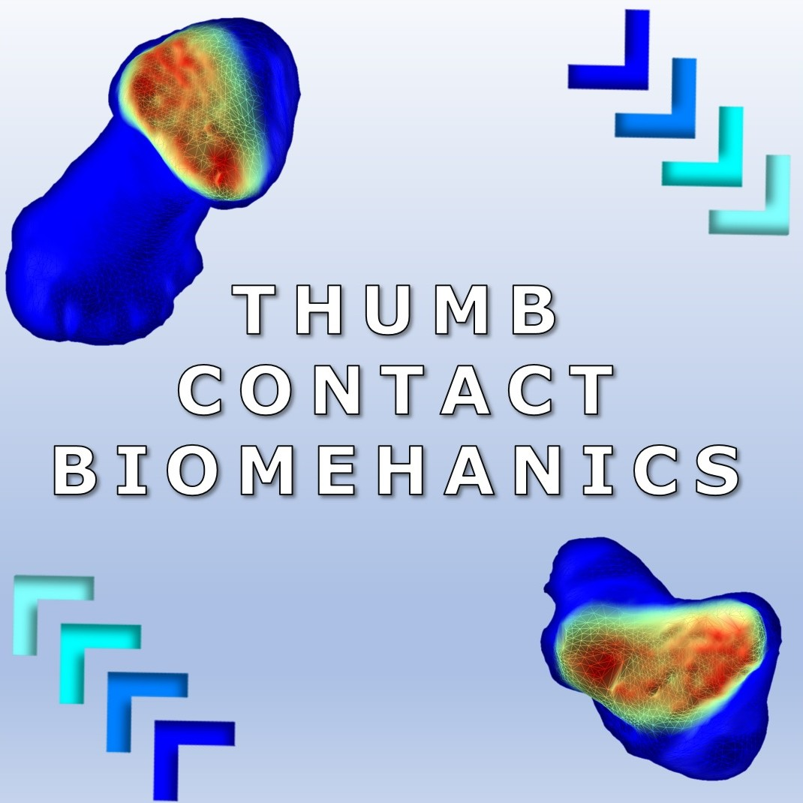

Slide 2
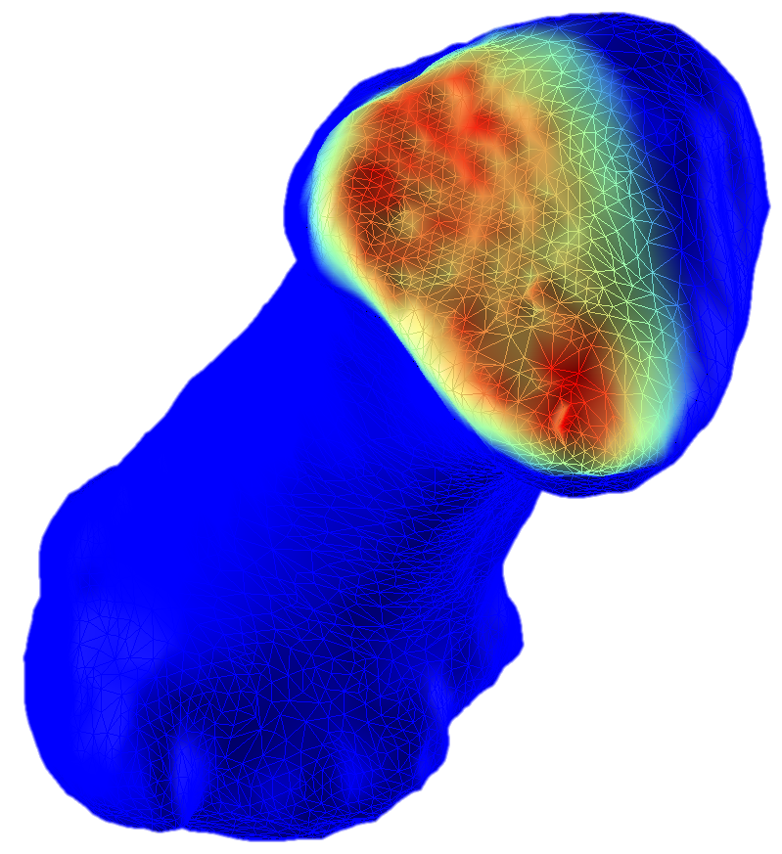
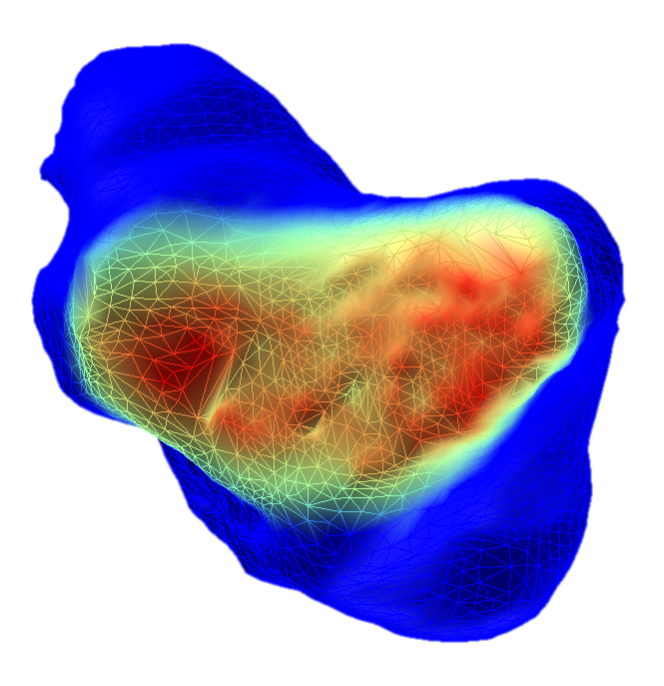
Measuring Intra-Articular Joint Pressure
via Medical Imaging

Slide 3
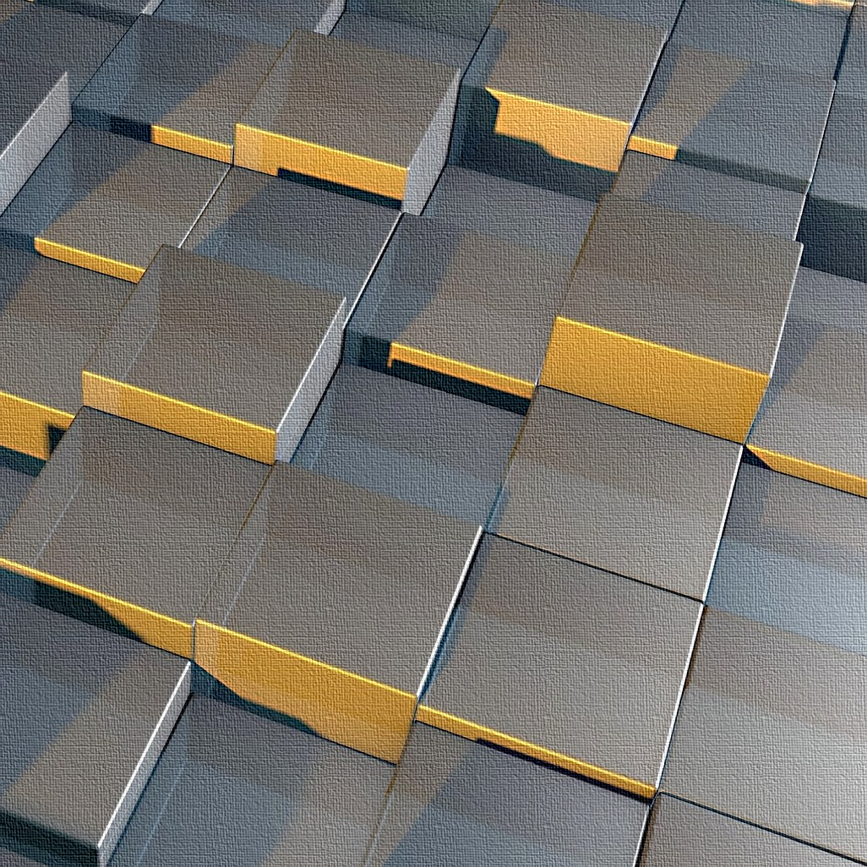
3D
Transformations

Slide 4
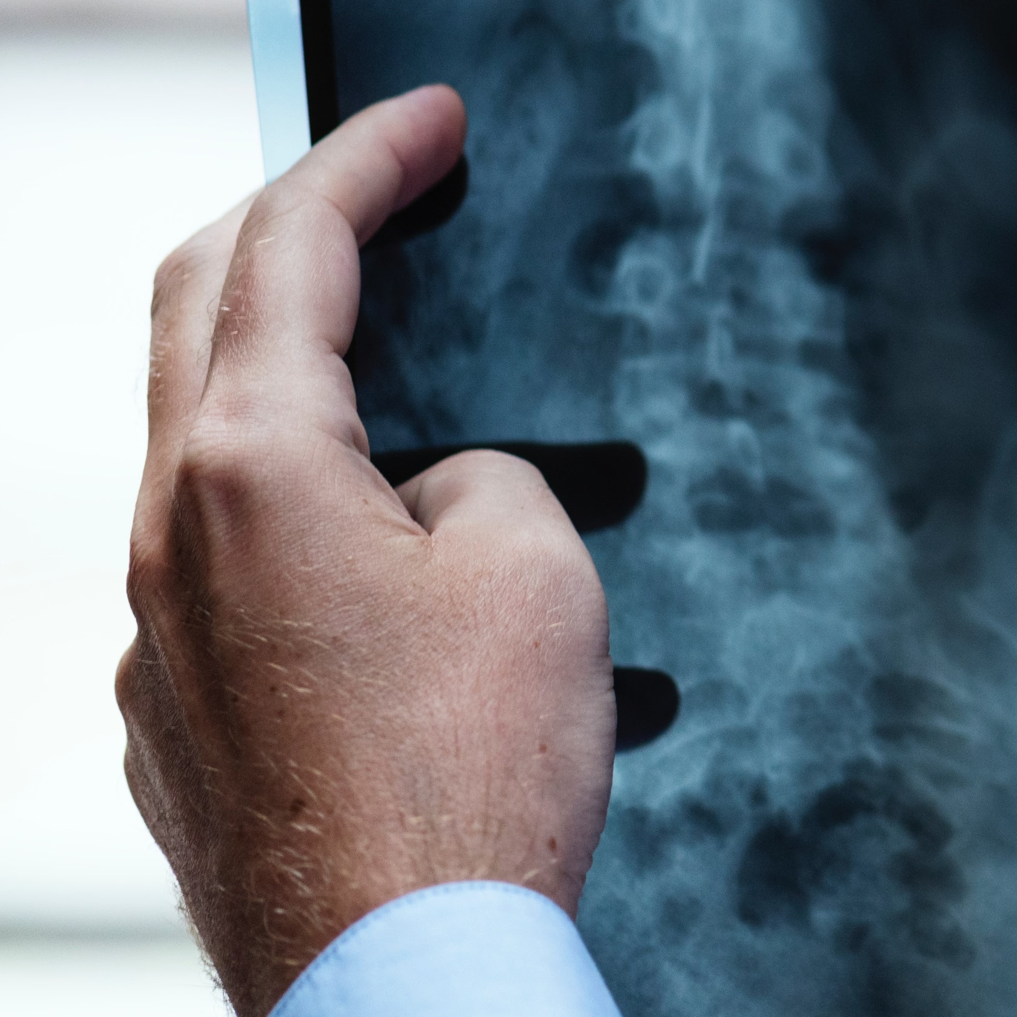
Assessing Joints Mobility
via
Medical Imaging

Slide 5

Assessing Hand Mobility
via
Dynamic Imaging

Slide 6
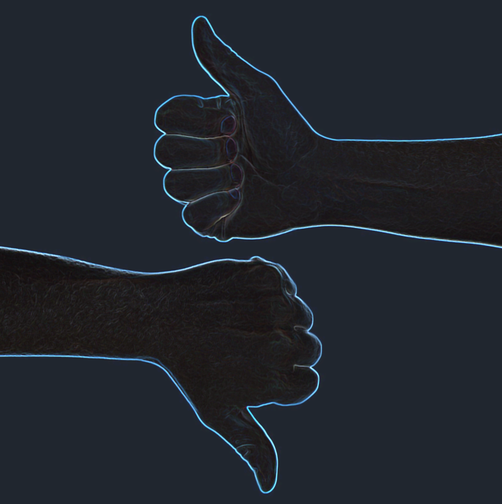
HEALTHY
Hand Biomechanics
Healthy vs. Arthritic

Slide 7
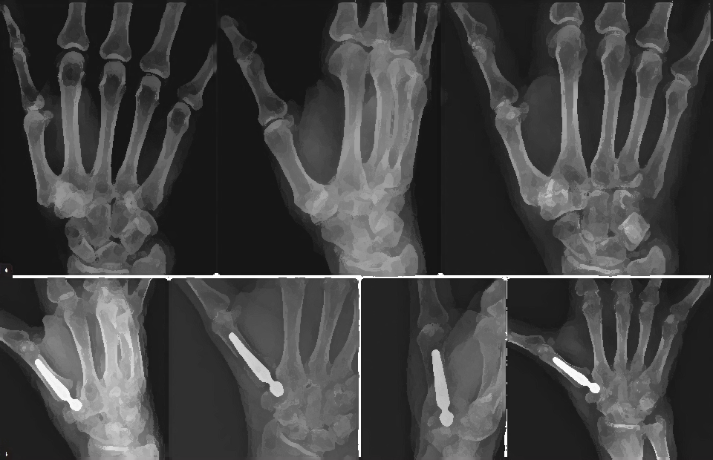
Impact of Implants
on
Thumb Mobility

Slide 8
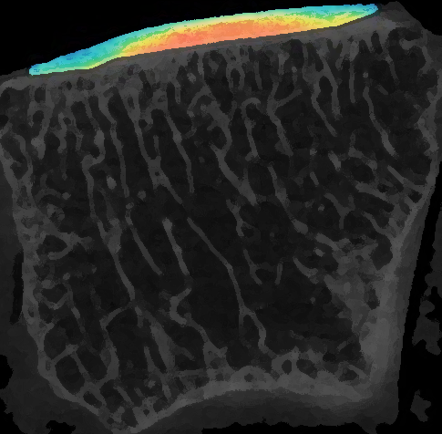
Assessing
Soft Tissues Properties
via Medical Imaging

Slide 9
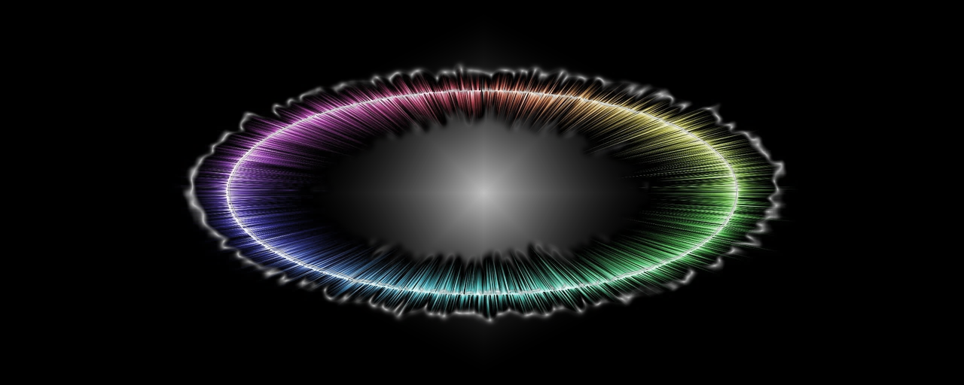
Signal Processing

Slide 10
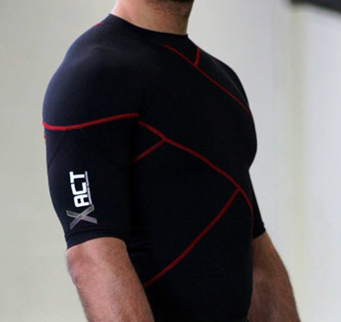
Impact of
Compression Garments
on Shoulder Stability

Slide 11

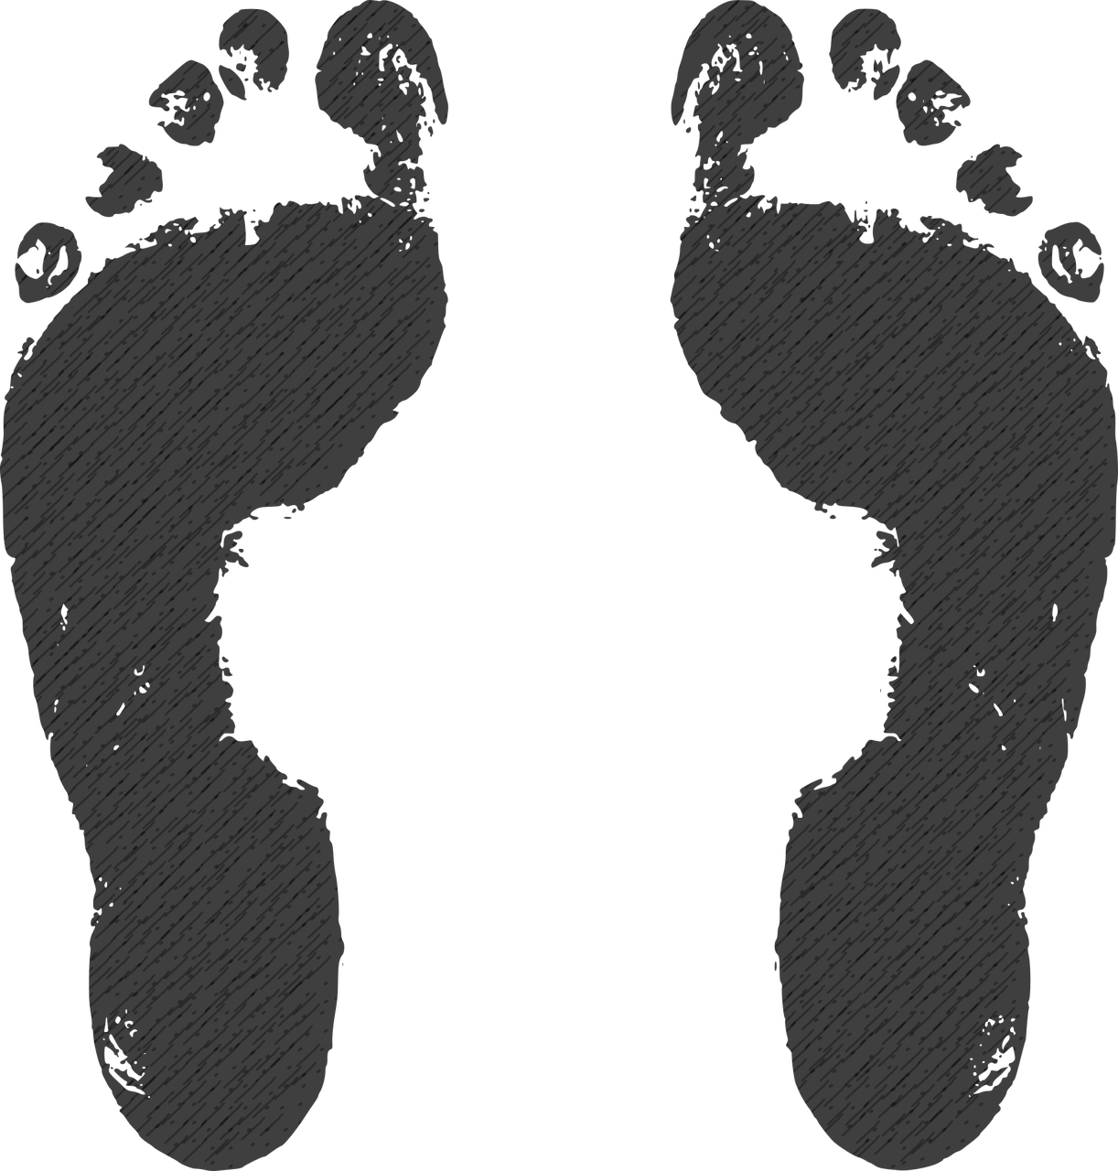
Comparing Foot
Pressure Measurement Technologies

Slide 12
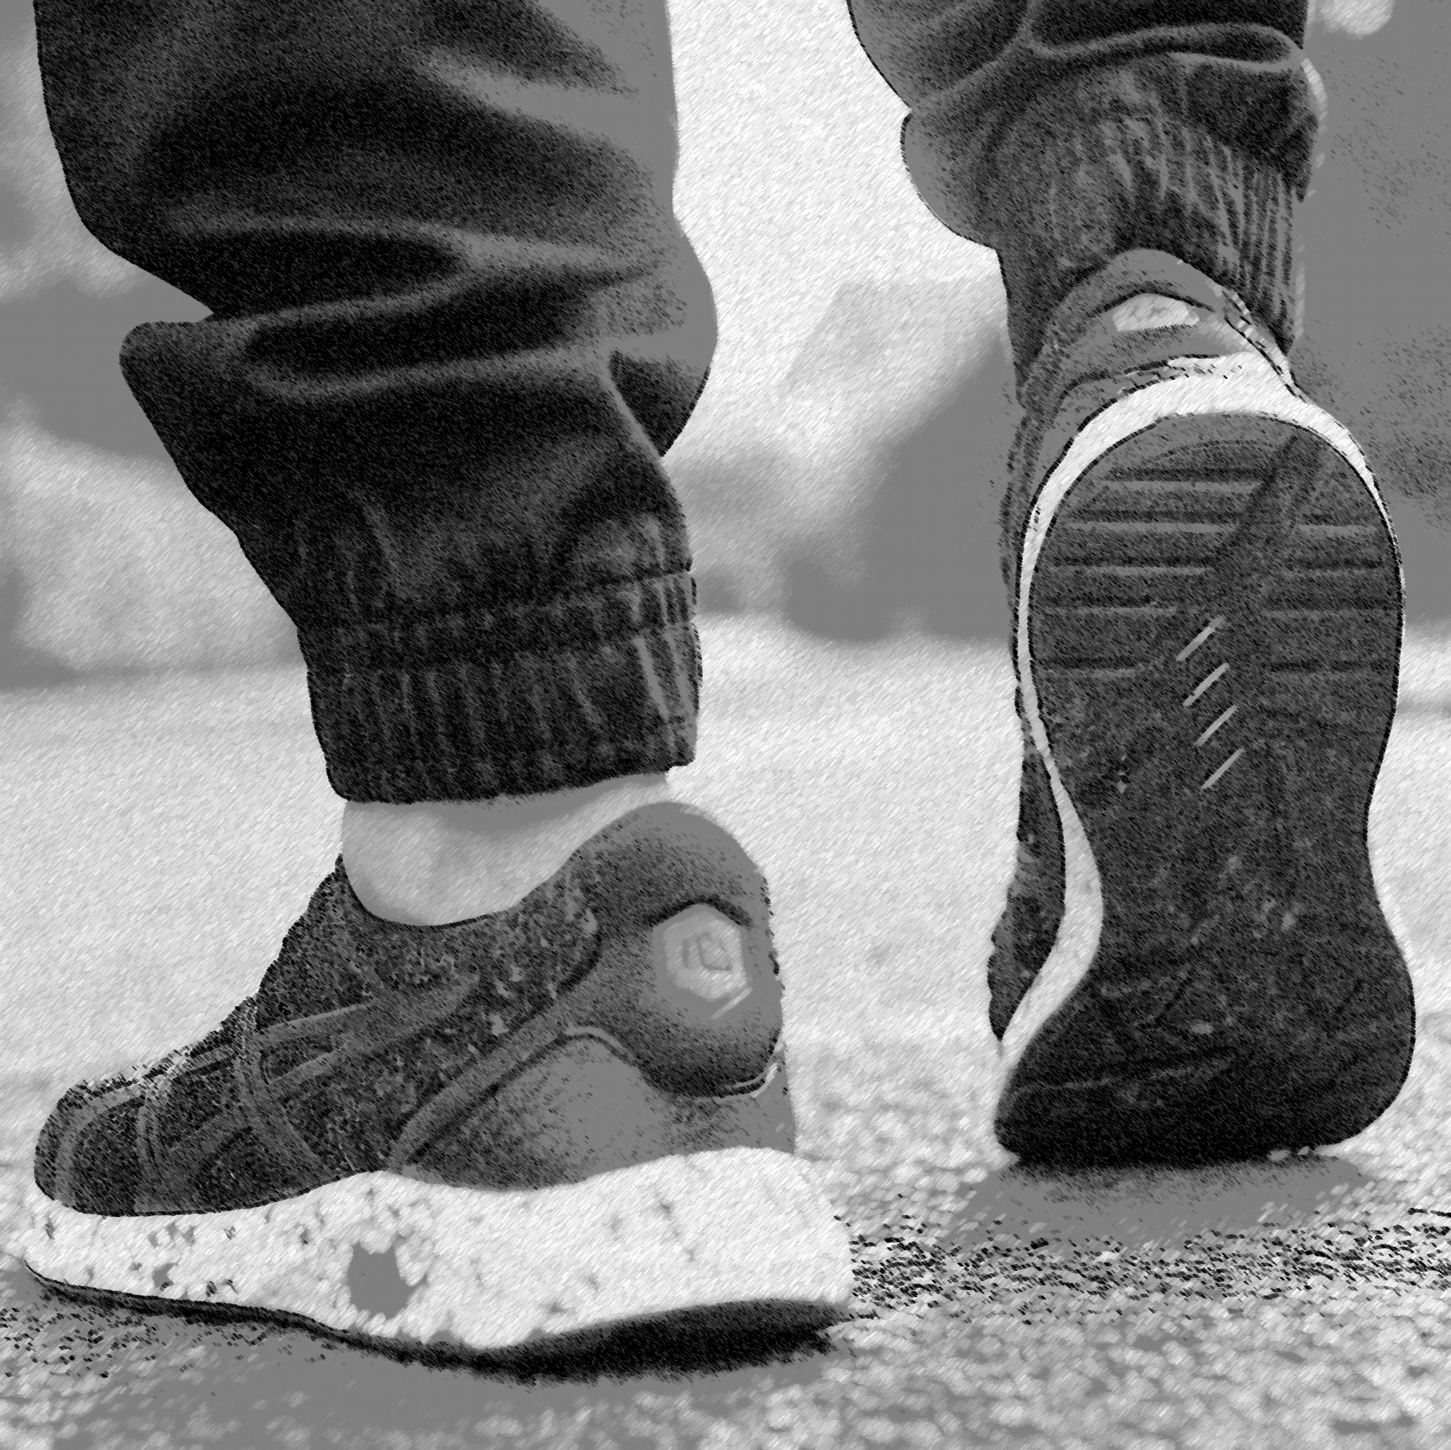
Measuring the Impact of Fatigue on Lower Limbs Biomechanics

Slide 13

Machine Learning

Slide 14

Computer Vision

Slide 15
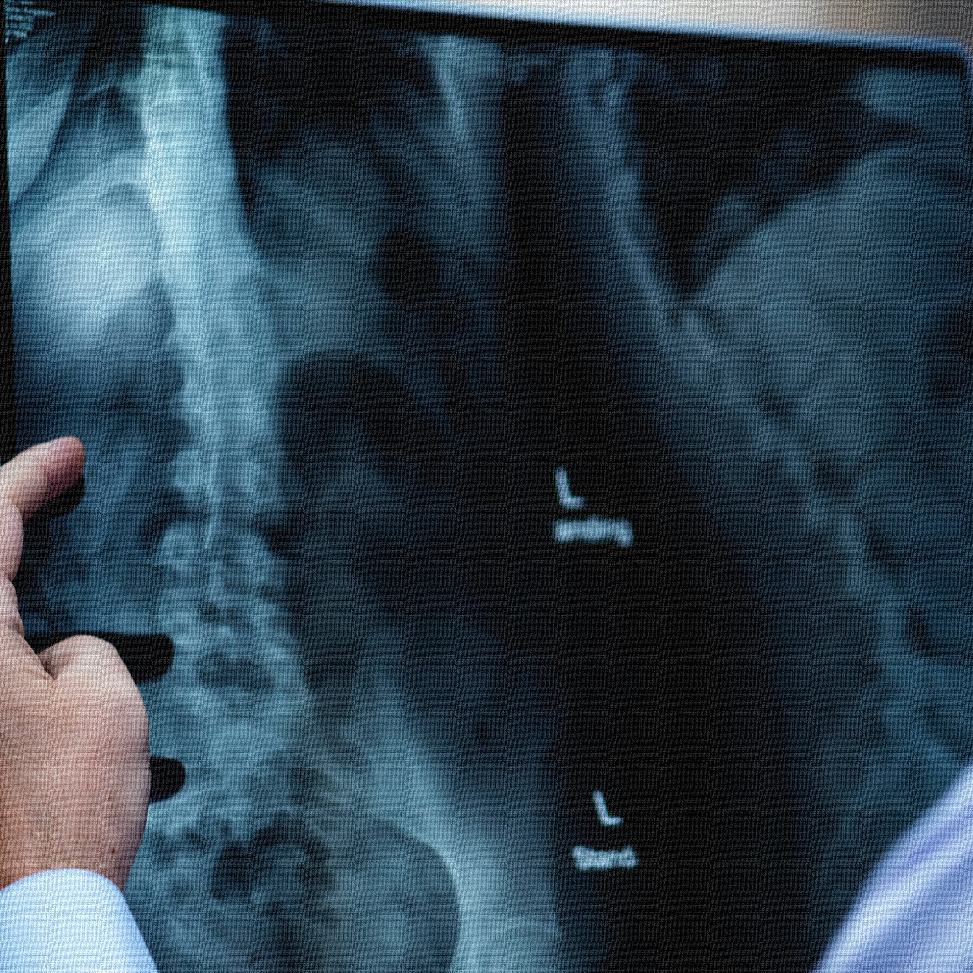
MEDICAL
IMAGING

Slide 16
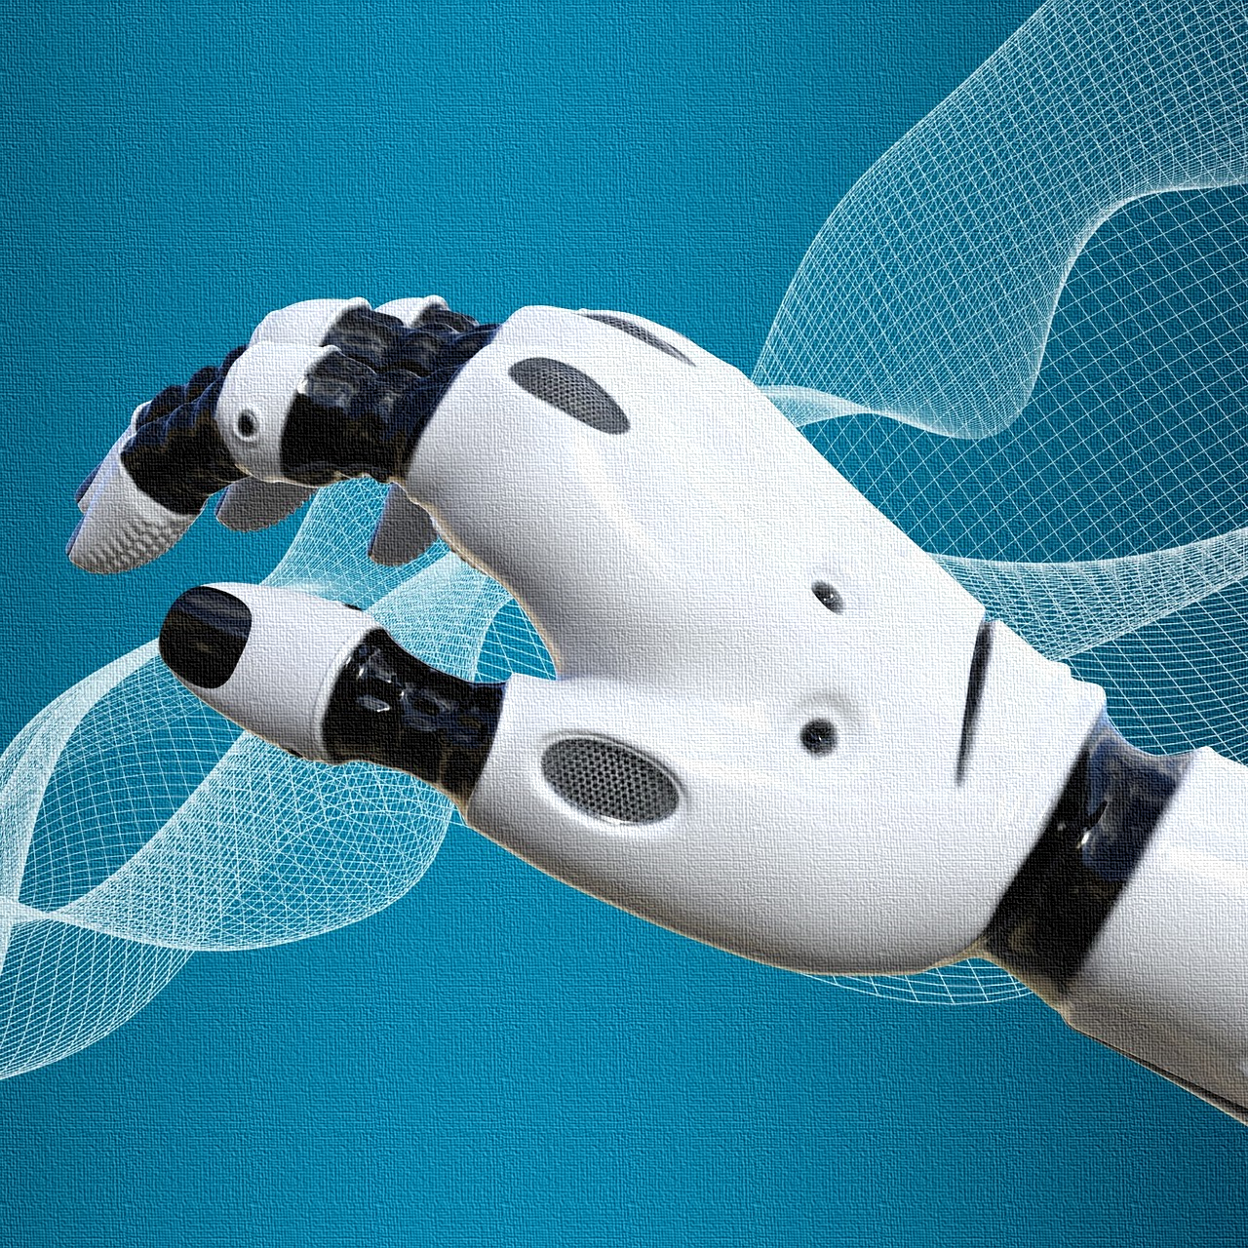
COMPUTER
MODELING

